Slide 1
Chapter 4
Top-Down Parsing
Recursive-Descent
Lijie Li
College of Computer Science & Technology
Harbin Engineering University
Compiler

Slide 2
Why & what is top-dow(bottom-up) parsing?
(34 –3) * 42
exp=> exp op exp
=> exp op number
=> exp * number
=> (exp) * number
=> (exp op exp) * number
=> (exp op number) * number
=> (exp – number ) * number
=> (number – number) * number
exp -> exp op exp | (exp) | number
op -> + | - | *
Compiler

Slide 3
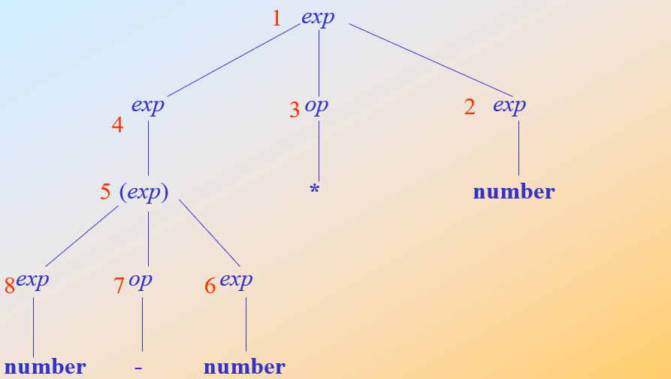
(34 –3) * 42

Slide 4
Top-down Parsing
A top-down parsing algorithm parses an input string of tokens by tracing out the steps in a leftmost derivation.
The traversal of the parse tree occurs from the root to the leaves.
Two forms of top-down parsing:
  Predictive parsers（预测分析）.
    Attempts to predict the next construction in the input string using one or more lookahead tokens.
  Backtracking parsers（回溯分析）.
    Tries different possibilities for a parse of the input, backing up an arbitrary amount in the input. May require exponential time
Compiler

Slide 5
Examples
exp
exp op exp
number + number
(1) exp => exp op exp
(2) => number op exp
(3) => number + exp
(4) => number + number
1
2
3
4
Leftmost derivation
Preorder numbering
(1) exp => exp op exp
(2) => exp op number
=> exp + number
=> number + number
exp
exp op exp
number + number
1
4
3
2
Rightmost derivation
The reverse of a Postorder numbering
Compiler

Slide 6
Two Kinds of Top-Down Parsing
Recursive-descent parsing
  Versatile
  Suitable for handwritten parser
LL(1) parsing
  No longer often used
  Simple scheme with explicit stack
  Prelude for more powerful and complex bottom-up algorithms
  First “L” – the input is processed from left to right
  Second “L” – leftmost derivation
  1 – one lookahead symbol
Compiler

Slide 7
Recursive-Descent
The grammar rule for a nonterminal A is viewed as a definition for a procedure that will recognize an A.
factor()
switch token
case(: match(();
exp();
match());
break;
case number:
match(number);
break;
default: error;
exp → exp addop term | term
addop → + | -
term → term mulop factor | factor
mulop → *
factor → (exp) | number
match(expToken)
if token = expToken then
getToken();
else error;
endif;
match matches the current token with its parameter, advances the input if it succeeds.
Compiler

Slide 8
Choice
statement → if-stmt | other
if-stmt → if (exp) statement [ else statement ]
exp → 0 | 1
ifStmt()
match(if);
match (();
exp();
match());
statement();
if token = else then
match (else);
statement();
end if;
EBNF is designed to mirror closely the actual code for recursive-descent parser.
Compiler

Slide 9
Repetition
Left recursive grammar:
A → A α | β β{α}
  Equivalent to β α*
exp → exp addop term | term
exp → term { addop term }
exp()
term();
while token = + or token = - do
match (token);
term();
end while;
Compiler

Slide 10
Syntax Tree for exp
exp → term { addop term }
exp:SyntaxTree()
temp = term;
while token = + or token = -
newtemp = makeOpNode(token);
match(token);
leftChild(newtemp) = temp;
rightChild(newtemp) = term;
temp = newtemp;
end while;
return temp;
Compiler

Slide 11
Syntax Tree for if-statement
statement -> if-stmt | other
if-stmt -> if (exp) statement [ else statement ]
exp -> 0 | 1
ifStatement:syntaxTree()
match(if);
match(();
temp = makeStmtNode(if);
testChild(temp) = exp;
match());
thenChild(temp) = statement;
if token = else then
match(else);
elseChild(temp) = statement;
else
elseChild(temp) = nil;
end if;
Compiler

Slide 12
Problems with Recursive-Descent
It may be difficult to convert a grammar into EBNF.
It may be difficult to distinguish two or more grammar rule options A → α | β, if both α and β begin with nonterminals.
(First set)
3. A → ε. It may be necessary to know what token can come after the nonterminal A.
(Follow set)
Compiler

Slide 13
Homework
4.2 Given the grammar A → ( A ) A | ε , write pseudocode to parse this grammar by recursive-descent.
4.3 Given the grammar
Write pseudocode to parse this grammar by recursive-descent.
statement → assign-stmt | call-stmt | other
assign-stmt → identifier := exp
call-stmt → identifier ( exp-list )
Compiler

